Slide 1
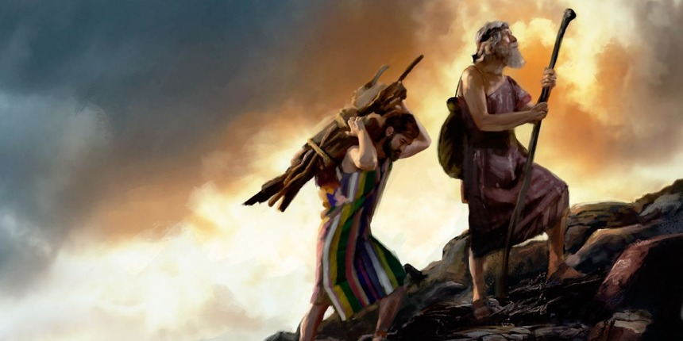
“…BUT WHERE IS THE LAMB?”
Genesis 22:1-7

Slide 2
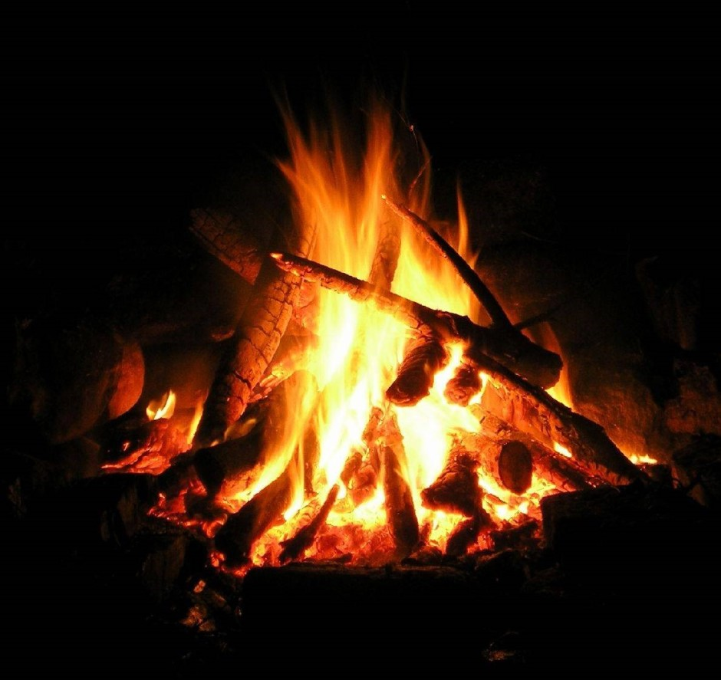
“Behold the fire and the wood…

Slide 3
“…BUT WHERE IS THE LAMB?”

Slide 4
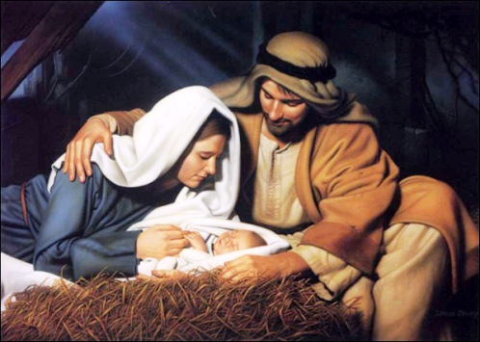
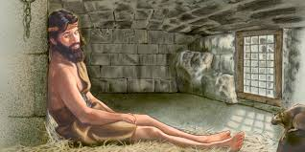
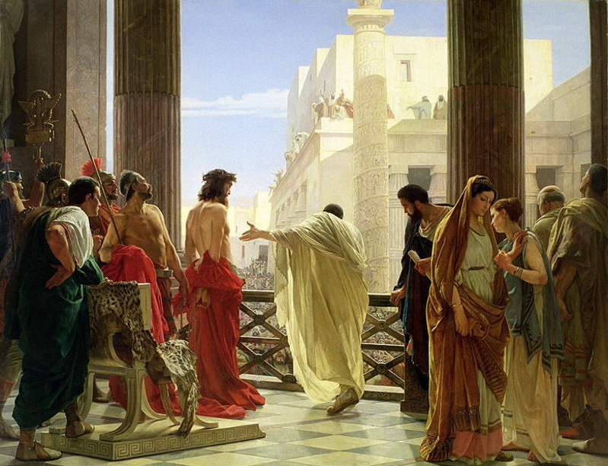
“…BUT WHERE IS THE LAMB?”

Slide 5
Types, symbols, pictures, stories, visions, dreams, miracles, sacrifices, prophesies…
“…BUT WHERE IS THE LAMB?”

Slide 6
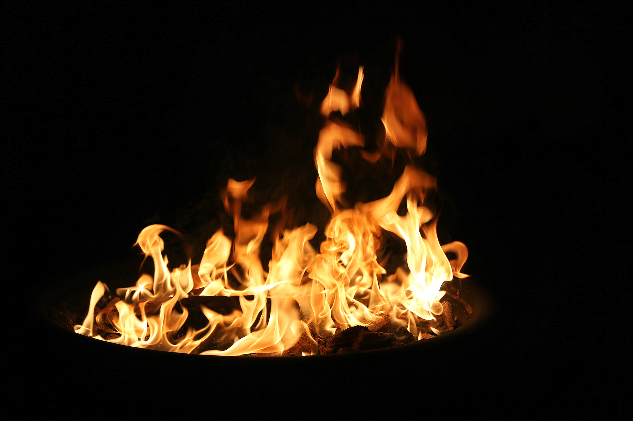
BEHOLD THE FIRE… BUT WHERE IS THE LAMB?
THE FIRE IS LITERAL

Slide 7
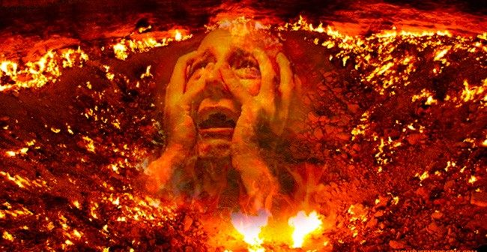
…the rich man also died, and was buried; And in hell he lift up his eyes, being in torments, and seeth Abraham afar off, and Lazarus in his bosom. Luke 16:22,23,24
…I am tormented in this flame.

Slide 8
BEHOLD THE FIRE… BUT WHERE IS THE LAMB?
THE FIRE IS LITERAL
THE FIRE IS SYMBOLIC
Condemnation
Commendation

Slide 9
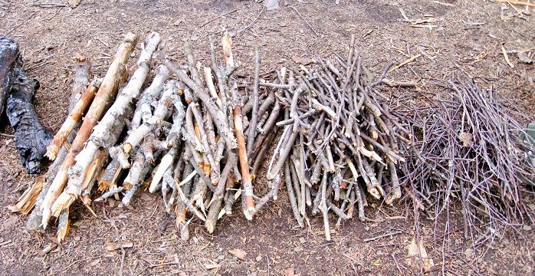
BEHOLD THE WOOD… BUT WHERE IS THE LAMB?
THE WOOD IS LITERAL
THE WOOD IS SYMBOLIC

Slide 10
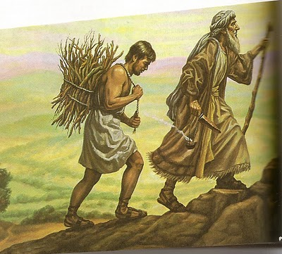
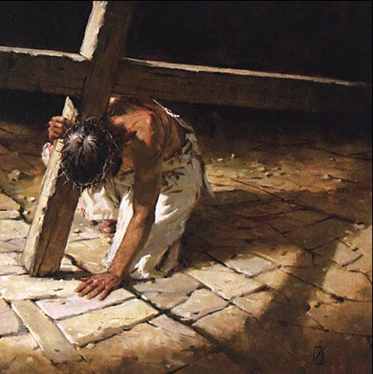
Abraham took the wood…and laid it upon Isaac his son.
And the Lord hath laid on Him the iniquity of us all.

Slide 11
BEHOLD THE FIRE – GOD ABSOLUTELY HOLY!
BEHOLD THE WOOD – MAN ABSOLUTELY SINFUL!

Slide 12
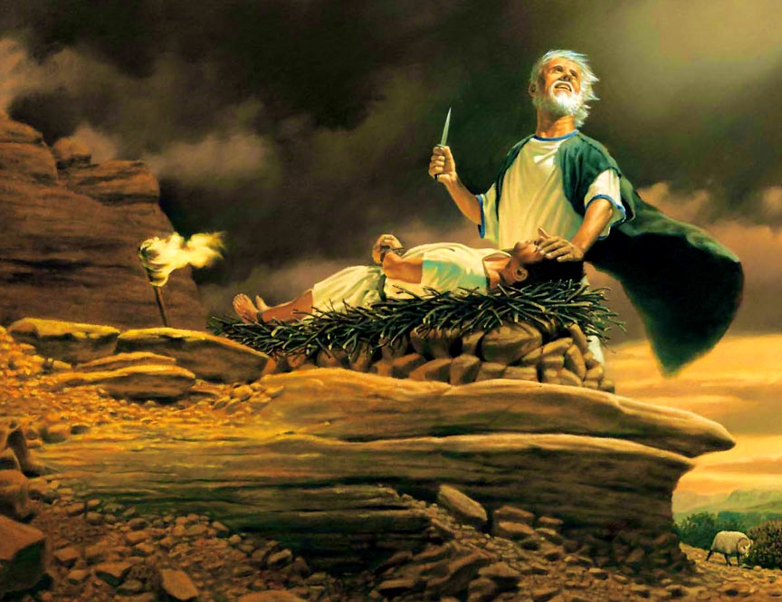
BEHOLD THE LAMB!
THE LAMB IS LITERAL
THE LAMB IS SYMBOLIC

Slide 13
BEHOLD THE LAMB!

Slide 14
